Slide 1
Communication Crash Course
A Quick Introduction to I/Q Convention and Modulation Types

Slide 2
Quadrature (IQ) Convention
IQ

Slide 3
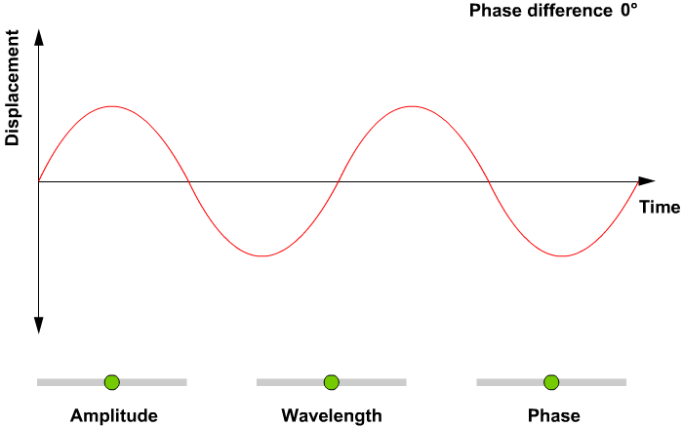
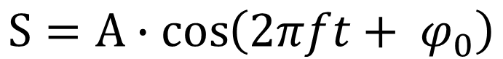
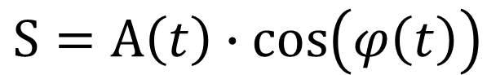
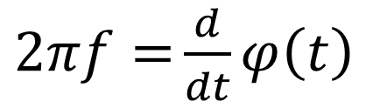
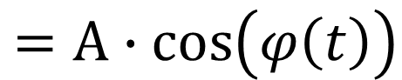
Properties of a Sinusoid
$$S=A∙cos\left(2πft+ φ_{0}\right)$$
$=A∙cos\left(φ\left(t\right)\right)$
(more general)
NOTE:
$2πf={\frac{d}{dt}φ\left(t\right)}$
$S=A\left(t\right)∙cos\left(φ\left(t\right)\right)$
(most general)

Slide 4
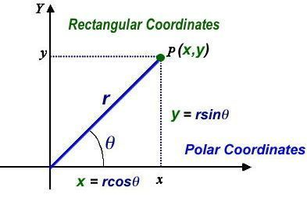
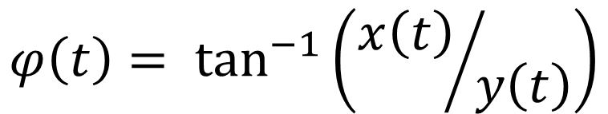
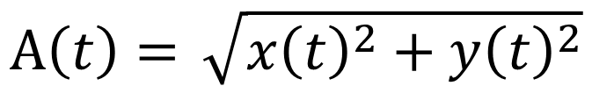
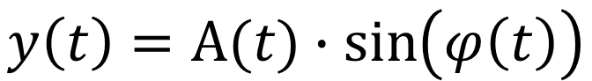
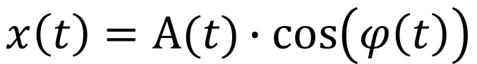
Polar to Cartesian
Polar
$$A\left(t\right)={\sqrt{{x\left(t\right)}^{2}+{y\left(t\right)}^{2}}}$$
$$φ\left(t\right)= \tan^{−1}\left({x\left(t\right)}/{y\left(t\right)}\right)$$
Cartesian
$$x\left(t\right)=A(t)∙cos\left(φ\left(t\right)\right)$$
$$y\left(t\right)=A(t)∙\sin\left(φ\left(t\right)\right)$$

Slide 5
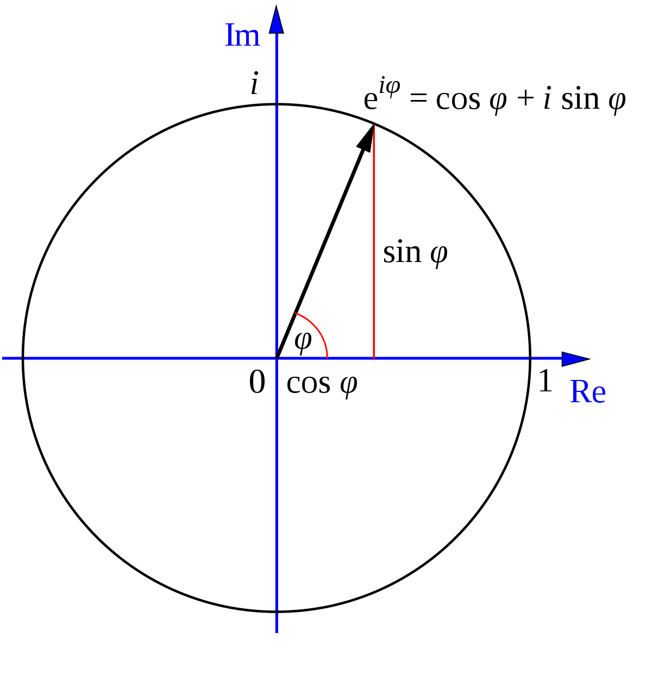
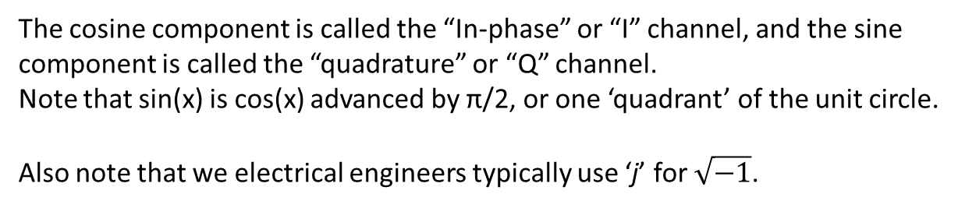
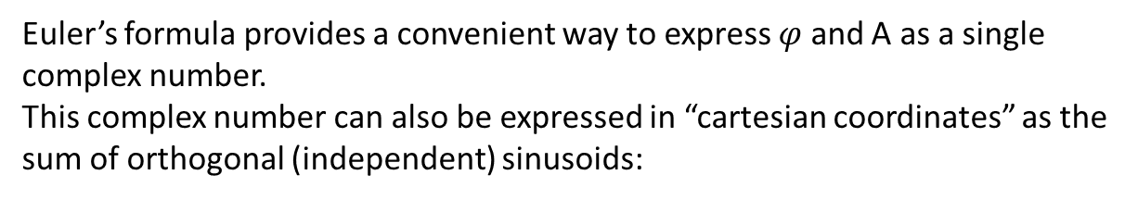
Euler’s Formula
$${A(t)∙e}^{iφ\left(t\right)}={A(t)∙\left[\cos{φ\left(t\right)}+i\sin{φ\left(t\right)}\right] }$$
Euler’s formula provides a convenient way to express $φ$ and A as a single complex number.
This complex number can also be expressed in “cartesian coordinates” as the sum of orthogonal (independent) sinusoids:
$$x\left(t\right)=A(t)∙cos{φ\left(t\right)→I channel}$$
$y\left(t\right)=A\left(t\right)∙\sin{φ\left(t\right)}→Q channel$
The cosine component is called the “In-phase” or “I” channel, and the sine component is called the “quadrature” or “Q” channel.
Note that sin(x) is cos(x) advanced by π/2, or one ‘quadrant’ of the unit circle.
Also note that we electrical engineers typically use ‘j’ for $\sqrt{−1}$.

Slide 6
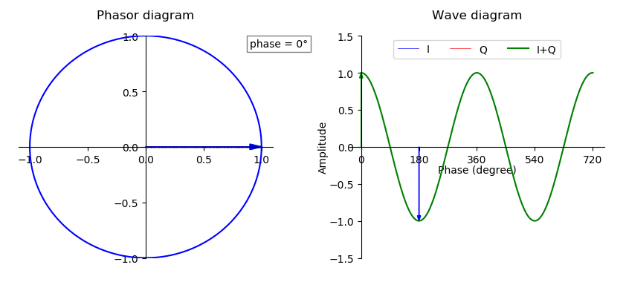
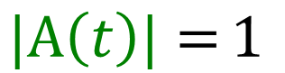
I and Q channels
Amplitude and Phase
I channel
Q channel
$${A(t)∙e}^{iφ\left(t\right)}={A(t)∙\left[\cos{φ\left(t\right)}+i\sin{φ\left(t\right)}\right] }$$
$$|A\left(t\right)|={1 }$$

Slide 7
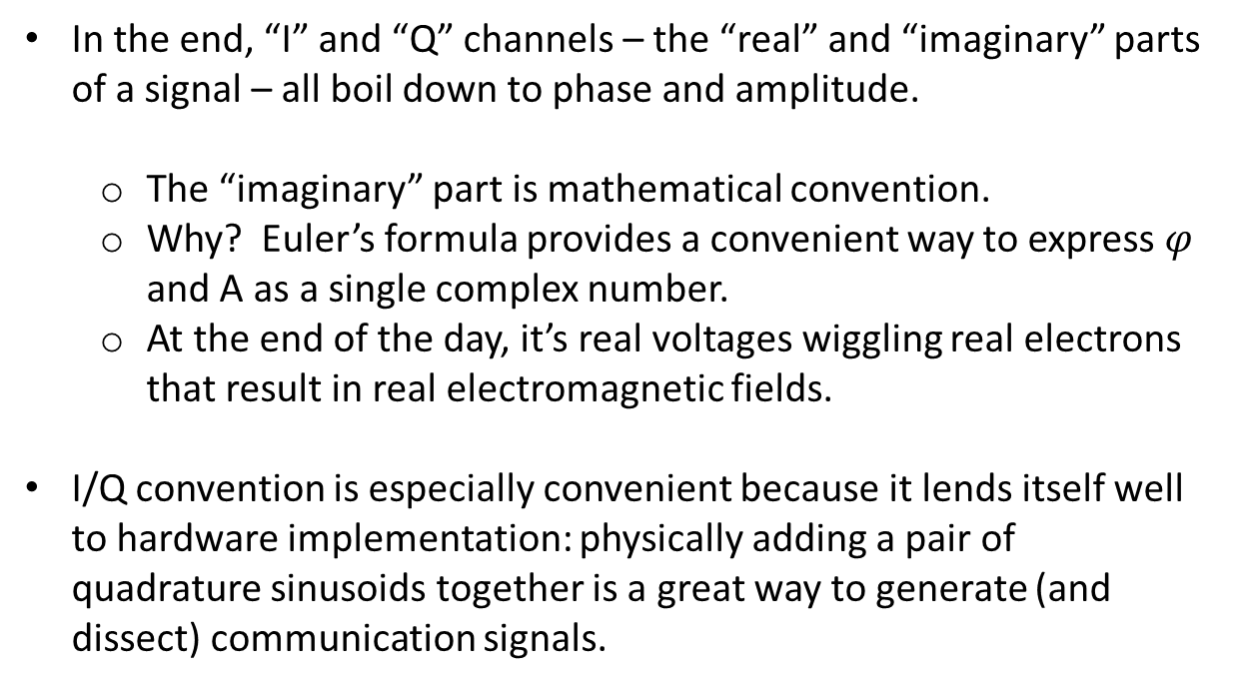
I and Q channels - Summary
In the end, “I” and “Q” channels – the “real” and “imaginary” parts of a signal – all boil down to phase and amplitude.
The “imaginary” part is mathematical convention.
Why? Euler’s formula provides a convenient way to express $φ$ and A as a single complex number.
At the end of the day, it’s real voltages wiggling real electrons that result in real electromagnetic fields.
I/Q convention is especially convenient because it lends itself well to hardware implementation: physically adding a pair of quadrature sinusoids together is a great way to generate (and dissect) communication signals.

Slide 8
Any Questions So Far?
?

Slide 9
OOK, NRZ, BPSK, QPSK
4-QAM, 16-QAM, 64-QAM
8-PSK, 256-QAM
1024-QAM…
Digital Modulation Schemes

Slide 10
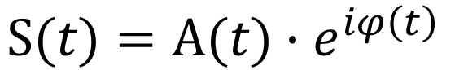
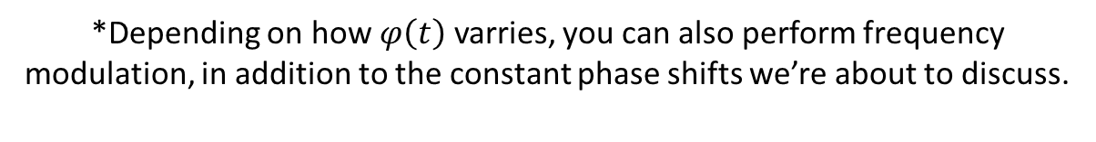
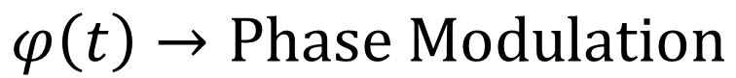
Introduction to M-QAM modulations
$$S(t){=A(t)∙e}^{iφ\left(t\right)}{ }$$
$$S(t)=A(t)∙\left[\cos{φ\left(t\right)}+i\sin{φ\left(t\right)}\right]$$
$$A\left(t\right)→Amplitude Modulation$$
Change the amplitude and/or phase of the signal to send information.
$$φ\left(t\right)→Phase Modulation$$
*Depending on how $φ\left(t\right)$ varries, you can also perform frequency modulation, in addition to the constant phase shifts we’re about to discuss.

Slide 11
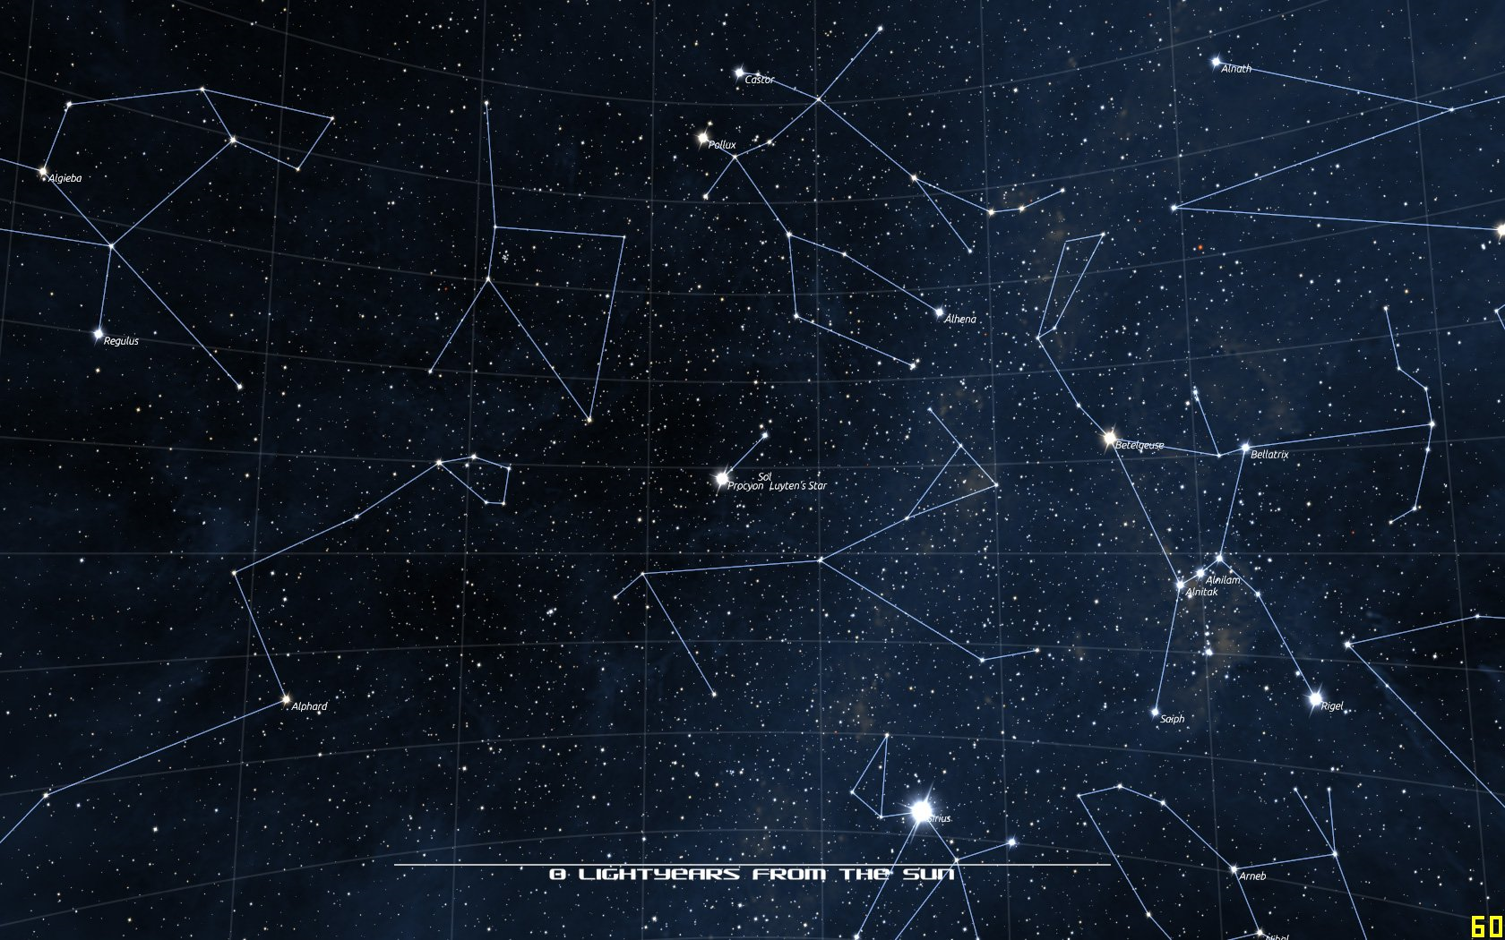
Constellation Diagrams
A constellation diagram is a plot of the I-channel versus the Q-channel.
Another way to see it is as a phasor (polar) plot of phase and amplitude over time.
Constellation diagrams can be useful for visualizing communication data.

Slide 12
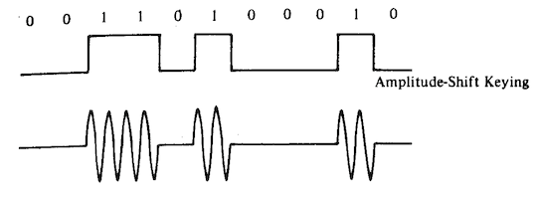
Amplitude Shift Keying (OOK, ASK)
Im (Q)
Distinct combinations of amplitude and phase are called “symbols.”
Phase does not change and is zero by convention.
Amplitude varies between on (1) and off (0).
0
1
Re (I)

Slide 13
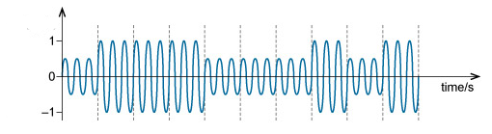
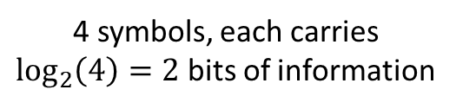
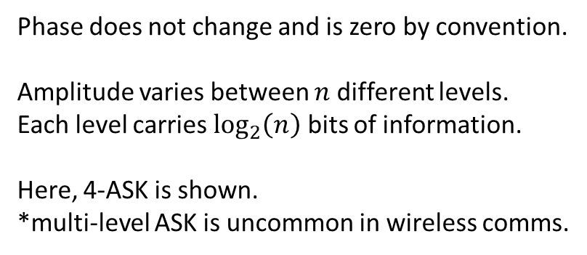
Multi-level Amplitude Shift Keying (m-ASK)
Im (Q)
4 symbols, each carries $\log_{2}\left(4\right)=2$ bits of information
Phase does not change and is zero by convention.
Amplitude varies between $n$ different levels.
Each level carries $\log_{2}\left(n\right)$ bits of information.
Here, 4-ASK is shown.
*multi-level ASK is uncommon in wireless comms.
00
01
11
10
Re (I)

Slide 14
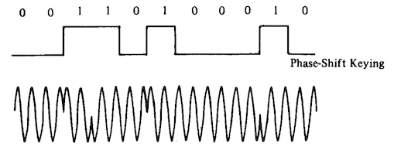
Binary Phase Shift Keying (BPSK, 2-PSK)
Im (Q)
Each symbol lies A units away from the center. The greater distance between symbols results in higher noise tolerance, compared to OOK.
Phase varies between 0 and π.
Amplitude remains constant.
0
1
Re (I)

Slide 15
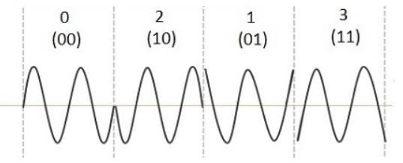
Quadrature Phase Shift Keying (QPSK, 4-PSK)
Im (Q)
4 symbols, each carries $\log_{2}\left(4\right)=2$ bits of information
Phase takes on one of 4 possible values:
0, π/2, π, and 3π/2.
Amplitude remains constant.
01
11
00
Re (I)
10

Slide 16
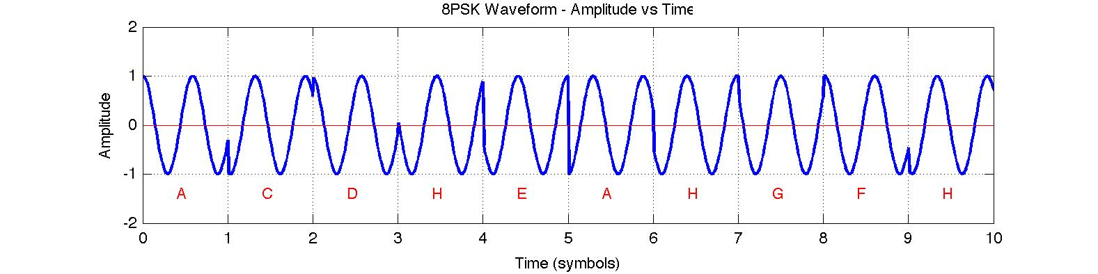
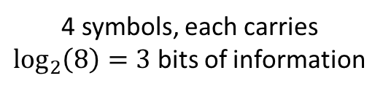
Quadrature Phase Shift Keying (QPSK, 4-PSK)
Im (Q)
4 symbols, each carries $\log_{2}\left(8\right)=3$ bits of information
Phase takes on one of 8 possible values,
integer multiples of 2π/8 = π/4.
Amplitude remains constant.
011
010
001
110
000
Re (I)
111
100
101

Slide 17
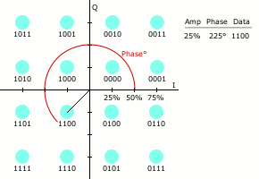
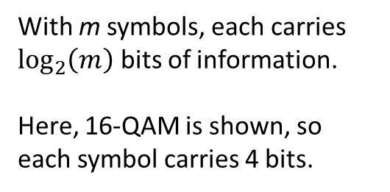
Quadrature Amplitude Modulation (m-QAM)
Im (Q)
Both amplitude and phase are modulated to efficiently pack symbols into the I/Q plane.
With m symbols, each carries $\log_{2}\left(m\right)$ bits of information.
Here, 16-QAM is shown, so each symbol carries 4 bits.
Re (I)

Slide 18
Bandwidth
BANDWIDTH

Slide 19
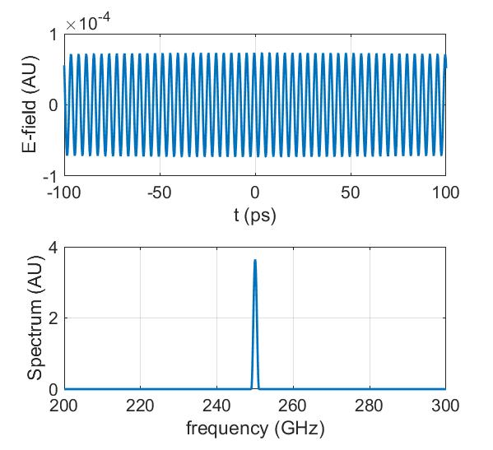
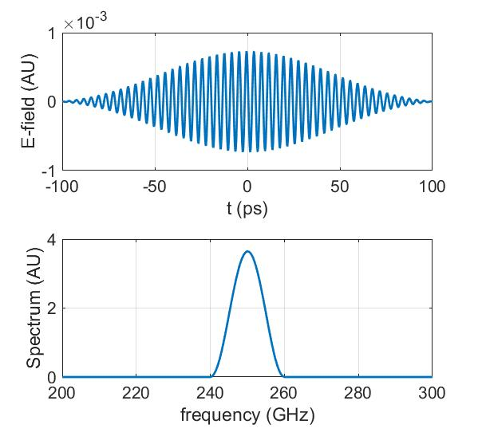
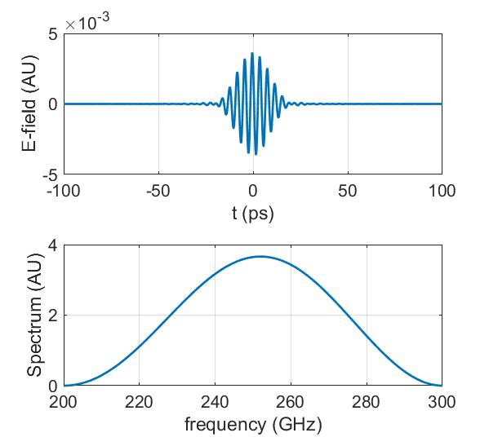
Time / Bandwidth Relationship
slow changes in time → low bandwidth
fast changes in time → high bandwidth
New information is sent by changing the state of the signal. The faster you make changes, the faster you send information.
Higher Data Rate → Higher Bandwidth
Quick Transitions → Higher Bandwidth

Slide 20
Problem
Problem: You can’t use up infinite bandwidth.
Hardware can’t handle it, and other people want you to share.

Slide 21
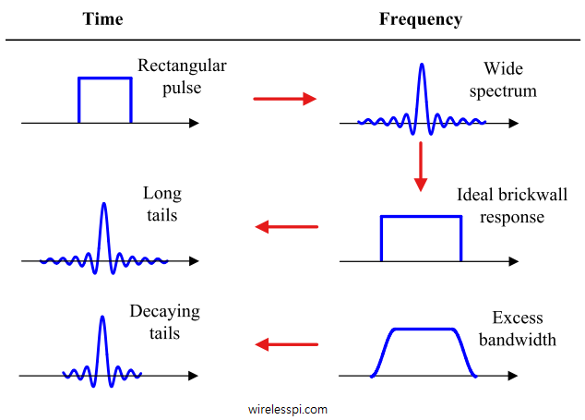
Raised Cosine Filters
Crisp time domain features → Power bleed in frequency
Power bleed in time ← Tight spectral confinement
Good in time
Bad in frequency*
Bad in time*
Good in frequency
raised cosine pulse shape
raised cosine filter
Functional
Compromise

Slide 22
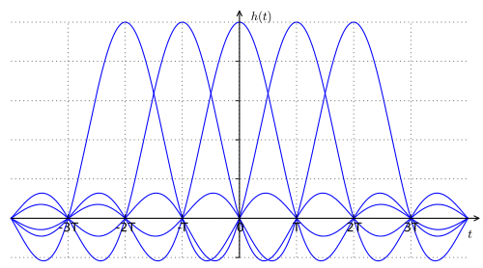
The great thing about SINC functions
If you sample the sum of the SINC functions correctly, they do not interfere with one another.

Slide 23
The great thing about SINC functions
This property of non-interference is called “orthogonality.” Signals can be orthogonal both time and frequency.

Slide 24
Pulse shaping summary
Fast time domain features result in higher bandwidth.
Unnecessarily fast time domain features result in excess bandwidth, which is bad.
Pulse Shaping (filtering) seeks a suitable compromise between limiting bandwidth and avoiding time-domain ISI.
SINC-like functions can be arranged orthogonally so that ISI is avoided, while bandwidth is still limited.
The Fourier transform pair of a decaying SINC function is a raised cosine shape.
Though not discussed, filtering also removes noise, boosting performance.

Slide 25
What in the world is OFDM?
OFDM

Slide 26
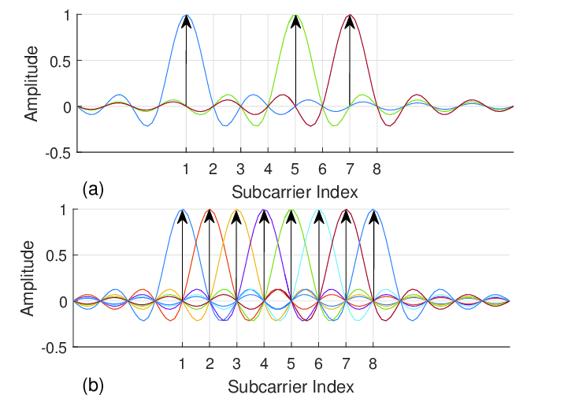
OFDM
1
0
0
0
1
0
1
0
OFDM is actually rather simple: It’s the same “pulse” shaping we’ve already seen.
However, instead of having time-domain SINC pulses that are orthogonal, swap time and frequency.
Now, you have SINC-shaped orthogonal frequency bands, and raised-cosine shaped “symbols” in the time domain.

Slide 27
OFDM
1
0
0
0
1
0
1
0
Takeaway
In m-QAM, data is transmitted using SINC-shaped symbols orthogonal in time.
In OFDM, data is transmitted using SINC-shaped symbols orthogonal in frequency.
In OFDM, frequency-domain and time-domain reverse roles, and the spectrum is sampled to recover the data.
Take the inverse Fourier transform of the spectrum to get a time-domain “symbol,” which is physically transmitted.
Because the spectrum is complex, you can also define multiple combinations of spectral amplitude and phase, resulting in modulations like QPSK-OFDM.

Slide 28
Any Questions?
?

